Slide 1
Lecture 3 –KNNs

Slide 2
Real-valued Features
sepal
petal
petal

Slide 3
Fisher Iris Dataset
Fisher (1936) used 150 measurements of flowers from 3 different species: Iris setosa (0), Iris virginica (1), Iris versicolor (2) collected by Anderson (1936)
Species | Sepal Length | Sepal Width | Petal Length | Petal Width
0 | 4.3 | 3.0 | 1.1 | 0.1
0 | 4.9 | 3.6 | 1.4 | 0.1
0 | 5.3 | 3.7 | 1.5 | 0.2
1 | 4.9 | 2.4 | 3.3 | 1.0
1 | 5.7 | 2.8 | 4.1 | 1.3
1 | 6.3 | 3.3 | 4.7 | 1.6
1 | 6.7 | 3.0 | 5.0 | 1.7
Source: https://en.wikipedia.org/wiki/Iris_flower_data_set

Slide 4
Fisher Iris Dataset
Fisher (1936) used 150 measurements of flowers from 3 different species: Iris setosa (0), Iris virginica (1), Iris versicolor (2) collected by Anderson (1936)
Species | Sepal Length | Sepal Width
0 | 4.3 | 3.0
0 | 4.9 | 3.6
0 | 5.3 | 3.7
1 | 4.9 | 2.4
1 | 5.7 | 2.8
1 | 6.3 | 3.3
1 | 6.7 | 3.0
Source: https://en.wikipedia.org/wiki/Iris_flower_data_set
Notes:
Let’s try to visualize it, and so only look at sepal length and width.

Slide 5


Fisher Iris Dataset
$$y=0$$
sepal length
$$y = 1$$
sepal width
Figure courtesy of Matt Gormley

Slide 6
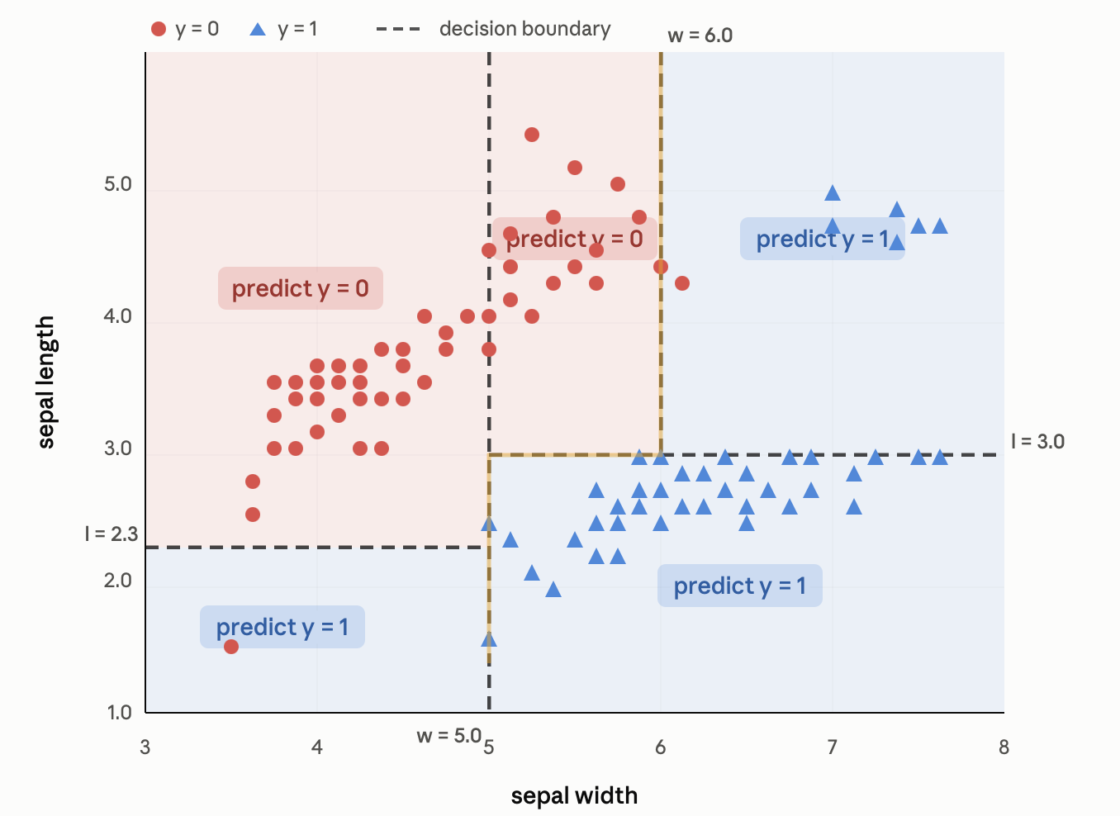
Decision Tree on Fisher Iris Dataset

Slide 7
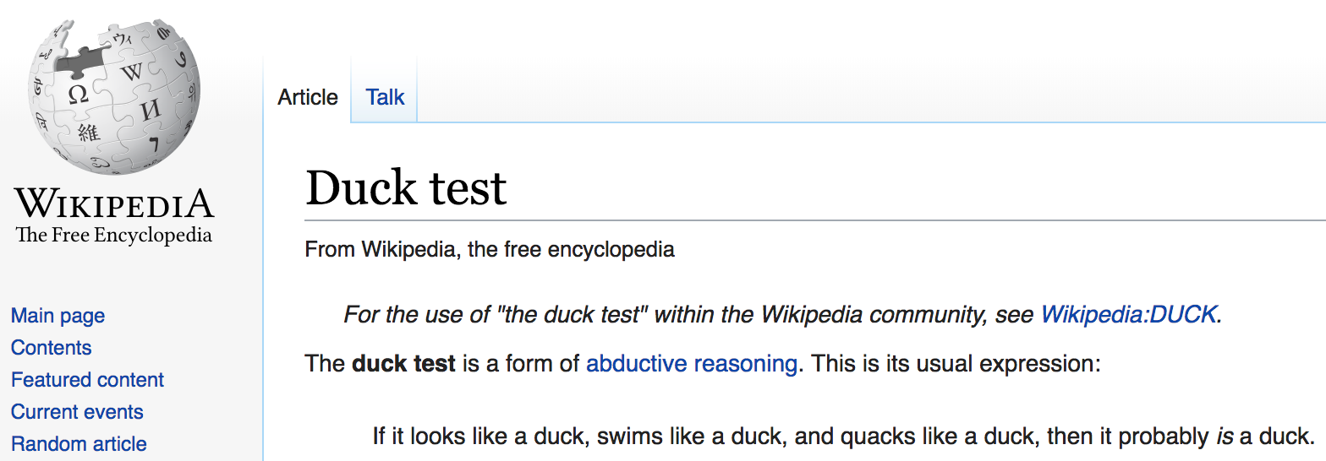
The Duck Test
Source: https://en.wikipedia.org/wiki/Duck_test
Notes:
you make the most plausible guess given the available evidence → that’s abductive reasoning
A form of common sense reasoning.
Inductive reasoning moves from specific observations to broad generalizations
abductive reasoning takes incomplete observations and jumps to the most likely explanation

Slide 8
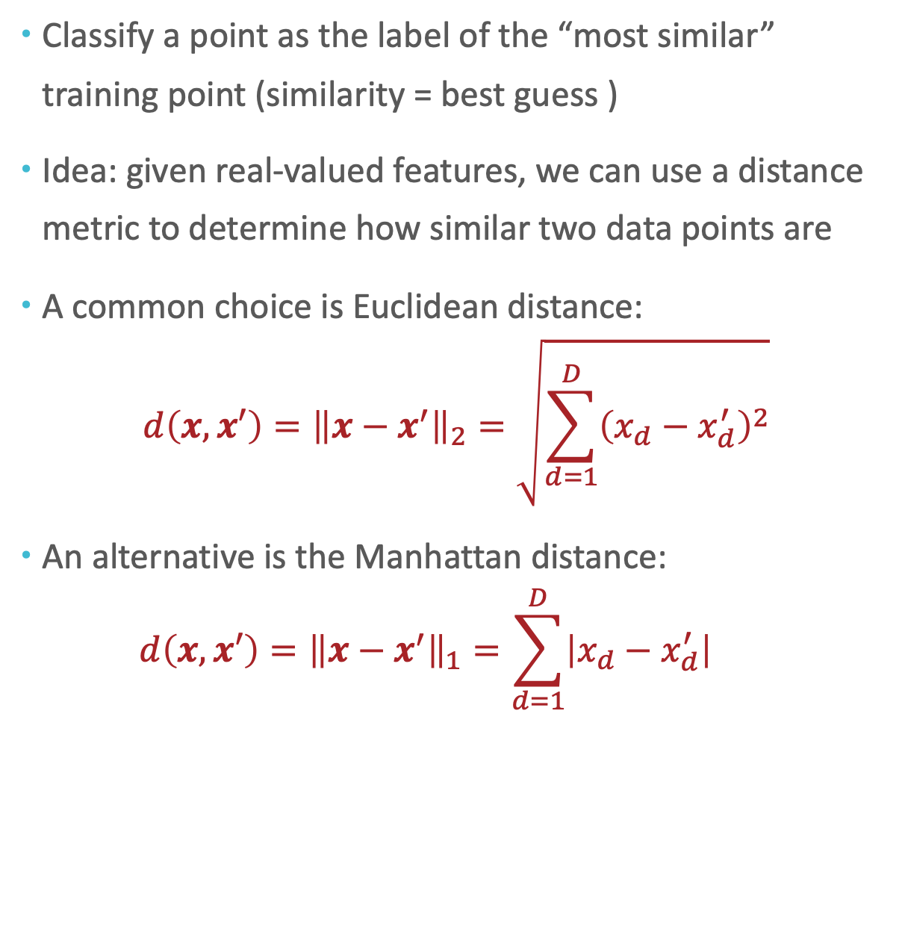
The Duck Test for Machine Learning
Classify a point as the label of the “most similar” training point (similarity = best guess )
Idea: given real-valued features, we can use a distance metric to determine how similar two data points are
A common choice is Euclidean distance:
$$d\left(x,x′\right)={\left\|x−x^{′}\right\|}_{2}=\sqrt{\sum_{d=1}^{D}{{\left(x_{d}−x_{d}^{′}\right)}^{2}}}$$
An alternative is the Manhattan distance:
$$d\left(x,x′\right)={\left\|x−x^{′}\right\|}_{1}=\sum_{d=1}^{D}{\left|x_{d}−x_{d}^{′}\right|}$$
Notes:
Is it memorization?

Slide 9
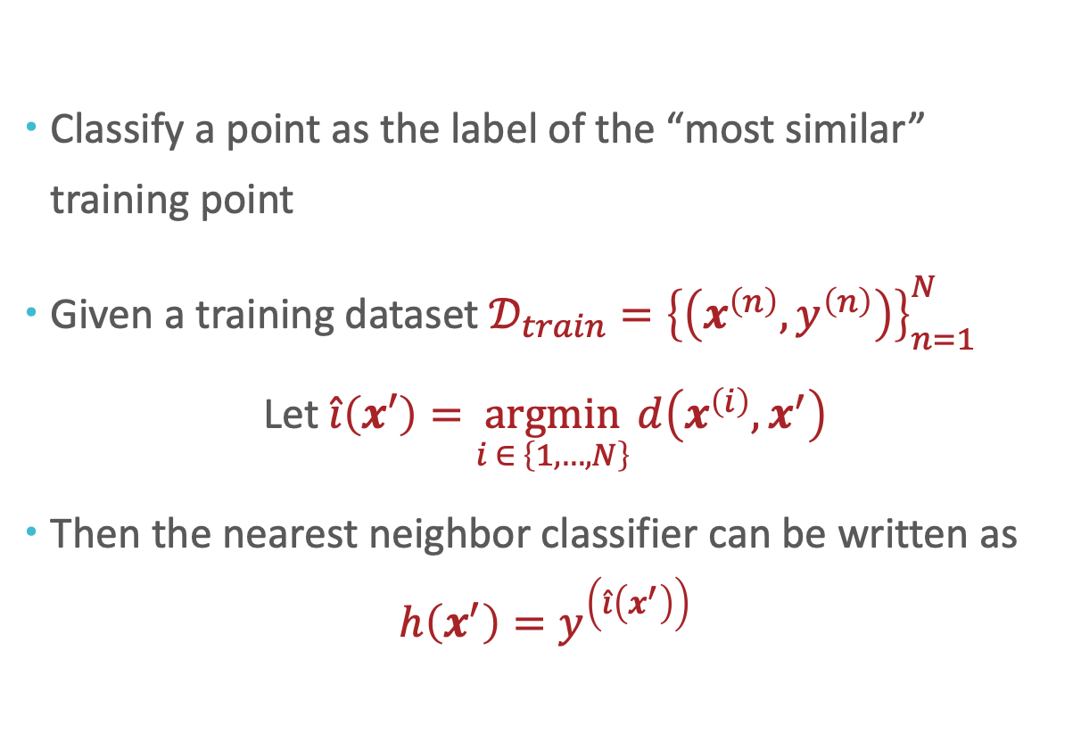
Nearest Neighbor Model
Classify a point as the label of the “most similar” training point
Given a training dataset $𝒟_{train}={\left\{\left(x^{\left(n\right)}, y^{\left(n\right)}\right)\right\}}_{n=1}^{N}$
$$\text{Let} \hat{i}\left(x′\right)=\underset{i ∈ \left\{1,…, N\right\}}{argmin}{d\left(x^{\left(i\right)},x^{′}\right)}$$
Then the nearest neighbor classifier can be written as
$$h\left(x^{′}\right)=y^{\left(\hat{i}\left(x^{′}\right)\right)}$$

Slide 10
Nearest Neighbor: Example

Slide 11
Nearest Neighbor: Example
Notes:
1NN=Voronoi diagram

Slide 12
Nearest Neighbor: Example

Slide 13
The Nearest Neighbor Model
Requires no training!
Always has zero training error!
A data point is always its own nearest neighbor (distance=0)

Slide 14
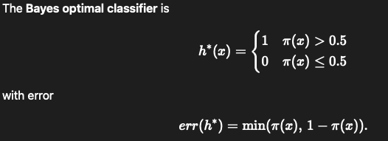
Bayes Optimal Classifier
Assume labels are stochastic: let $π\left(x\right)=P\left\{y=1 | x\right\}$
Notes:
Because it uses the bayes rule to compute the probability of each class label given a input data. Selects the highest probability.

Slide 15
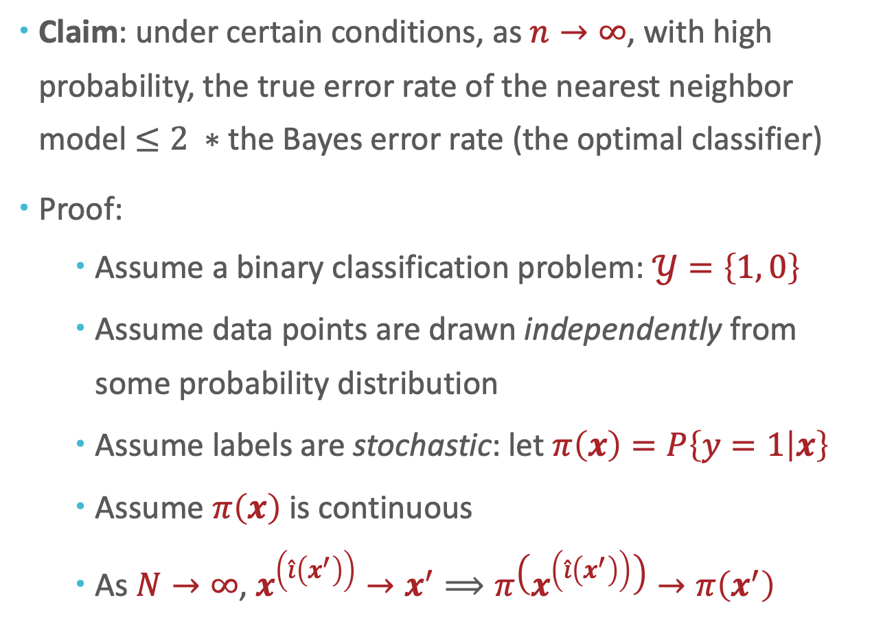
Generalization of Nearest Neighbor (Cover and Hart, 1967)
Claim: under certain conditions, as $n→∞$, with high probability, the true error rate of the nearest neighbor model $≤2 ∗$ the Bayes error rate (the optimal classifier)
Proof:
Assume a binary classification problem: $𝒴=\left\{1, 0\right\}$
Assume data points are drawn independently from some probability distribution
Assume labels are stochastic: let $π\left(x\right)=P\left\{y=1 | x\right\}$
Assume $π\left(x\right)$ is continuous
As $N→∞$, $x^{\left(\hat{i}\left(x^{′}\right)\right)}→x^{′}⟹π\left(x^{\left(\hat{i}\left(x^{′}\right)\right)}\right)→π\left(x^{′}\right)$
Source: https://ieeexplore.ieee.org/stamp/stamp.jsp?tp=&arnumber=1053964

Slide 16
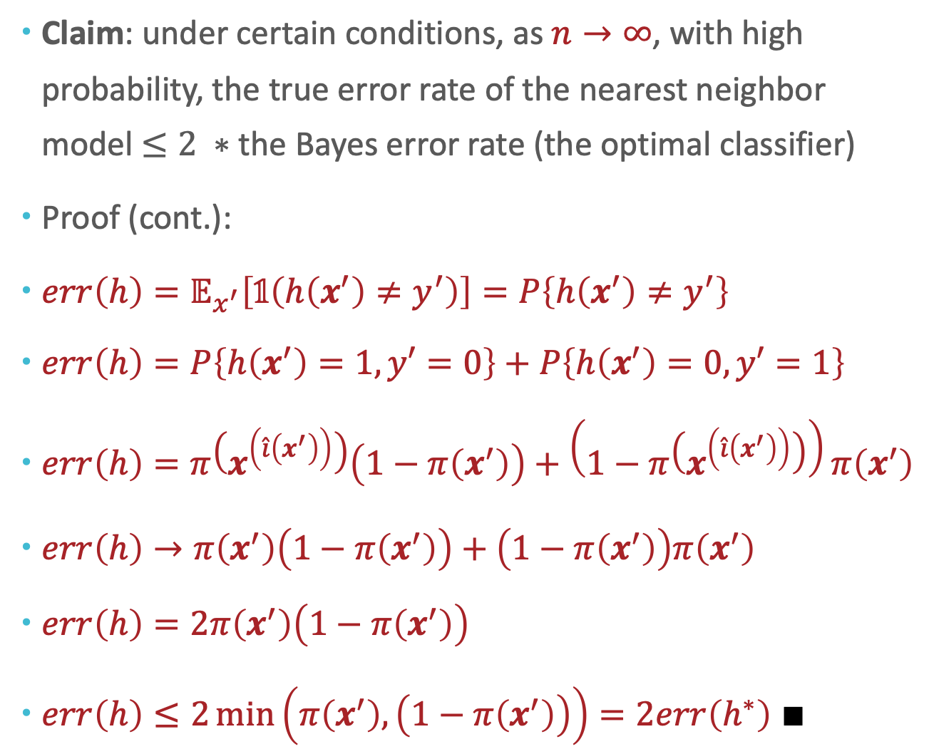
Generalization of Nearest Neighbor (Cover and Hart, 1967)
Claim: under certain conditions, as $n→∞$, with high probability, the true error rate of the nearest neighbor model $≤2 ∗$ the Bayes error rate (the optimal classifier)
Proof (cont.):
$err\left(h\right)=𝔼_{x^{′}}\left[\text{𝟙}\left(h\left(x^{′}\right)≠y^{′}\right)\right]=P\left\{h\left(x^{′}\right)≠y^{′}\right\}$
$err\left(h\right)=P\left\{h\left(x^{′}\right)=1, y′=0\right\}+P\left\{h\left(x^{′}\right)=0,y′=1\right\}$
$err\left(h\right)=π\left(x^{\left(\hat{i}\left(x^{′}\right)\right)}\right)\left(1−π\left(x^{′}\right)\right)+\left(1−π\left(x^{\left(\hat{i}\left(x^{′}\right)\right)}\right)\right)π\left(x^{′}\right)$
$err\left(h\right)→π\left(x^{′}\right)\left(1−π\left(x^{′}\right)\right)+\left(1−π\left(x^{′}\right)\right)π\left(x^{′}\right)$
$err\left(h\right)=2π\left(x^{′}\right)\left(1−π\left(x^{′}\right)\right)$
$err\left(h\right)≤2\min\left(π\left(x^{′}\right),\left(1−π\left(x^{′}\right)\right)\right)=2err\left(h^{∗}\right) ∎$
Source: https://ieeexplore.ieee.org/stamp/stamp.jsp?tp=&arnumber=1053964

Slide 17
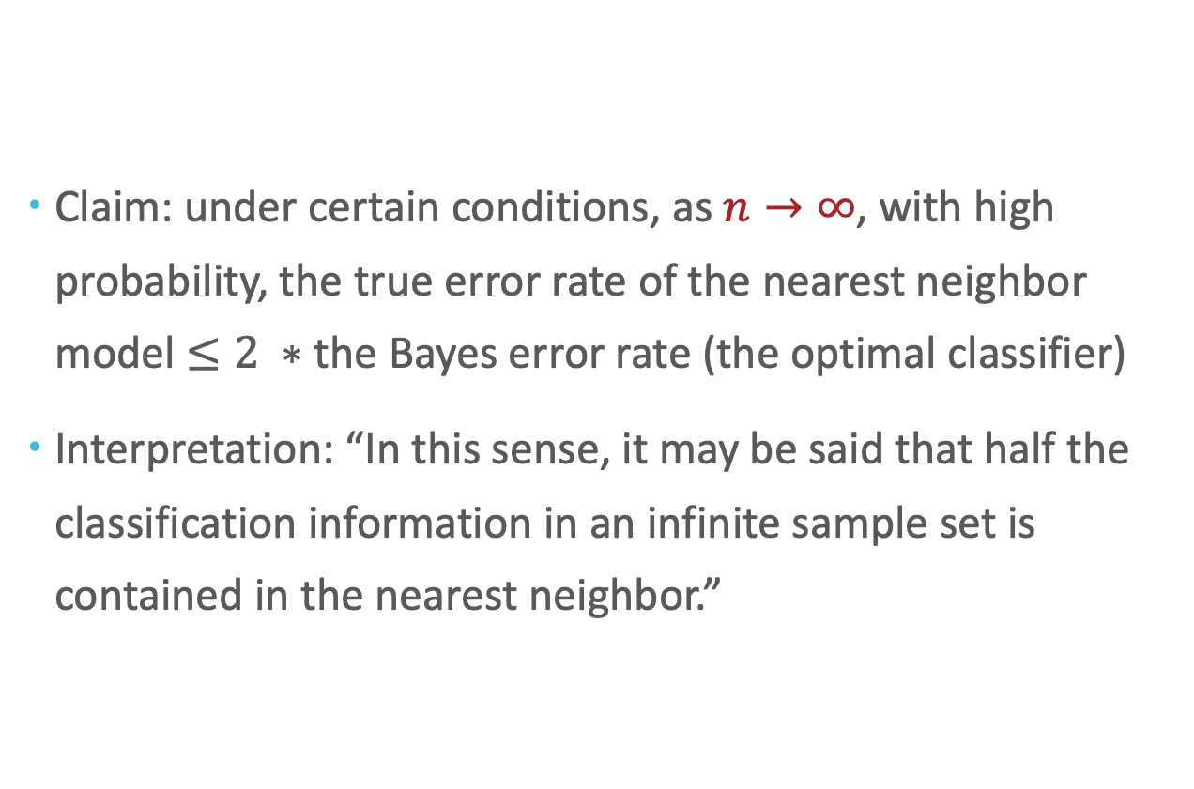
Generalization of Nearest Neighbor (Cover and Hart, 1967)
Claim: under certain conditions, as $n→∞$, with high probability, the true error rate of the nearest neighbor model $≤2 ∗$ the Bayes error rate (the optimal classifier)
Interpretation: “In this sense, it may be said that half the classification information in an infinite sample set is contained in the nearest neighbor.”
Source: https://ieeexplore.ieee.org/stamp/stamp.jsp?tp=&arnumber=1053964
Notes:
Another condition is, the probability distribution of classes condition on input feature, is continuous and smooth. Therefore, when two points are extremely close, their labels should also be similar.
P(x) also needs to be somewhat continuous.

Slide 18
But why limit ourselves to just one neighbor?
Claim: under certain conditions, as $n→∞$, with high probability, the true error rate of the nearest neighbor model $≤2 ∗$ the Bayes error rate (the optimal classifier)
Interpretation: “In this sense, it may be said that half the classification information in an infinite sample set is contained in the nearest neighbor.”
Source: https://ieeexplore.ieee.org/stamp/stamp.jsp?tp=&arnumber=1053964

Slide 19

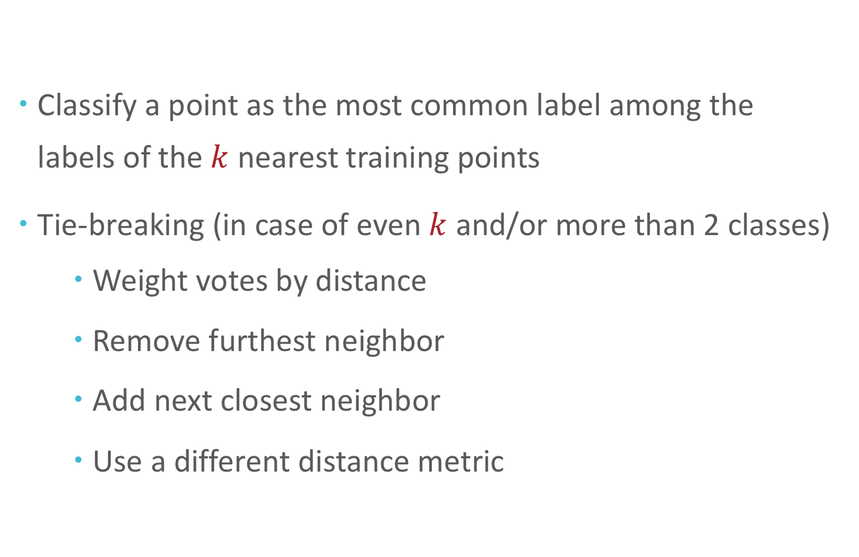
$k$-Nearest Neighbors ($k$NN)
Classify a point as the most common label among the labels of the $k$ nearest training points
Tie-breaking (in case of even $k$ and/or more than 2 classes)
Weight votes by distance
Remove furthest neighbor
Add next closest neighbor
Use a different distance metric

Slide 20

$k$NN on Fisher Iris Data
Figure courtesy of Matt Gormley

Slide 21
$k$NN on Fisher Iris Data
Figure courtesy of Matt Gormley

Slide 22
$k$NN on Fisher Iris Data
Figure courtesy of Matt Gormley

Slide 23
$k$NN on Fisher Iris Data
Figure courtesy of Matt Gormley

Slide 24
$k$NN on Fisher Iris Data
Figure courtesy of Matt Gormley

Slide 25
$k$NN on Fisher Iris Data
Figure courtesy of Matt Gormley

Slide 26
$k$NN on Fisher Iris Data
Figure courtesy of Matt Gormley

Slide 27
$k$NN on Fisher Iris Data
Figure courtesy of Matt Gormley

Slide 28
$k$NN on Fisher Iris Data
Figure courtesy of Matt Gormley

Slide 29
$k$NN on Fisher Iris Data
Figure courtesy of Matt Gormley

Slide 30
$k$NN on Fisher Iris Data
Figure courtesy of Matt Gormley

Slide 31
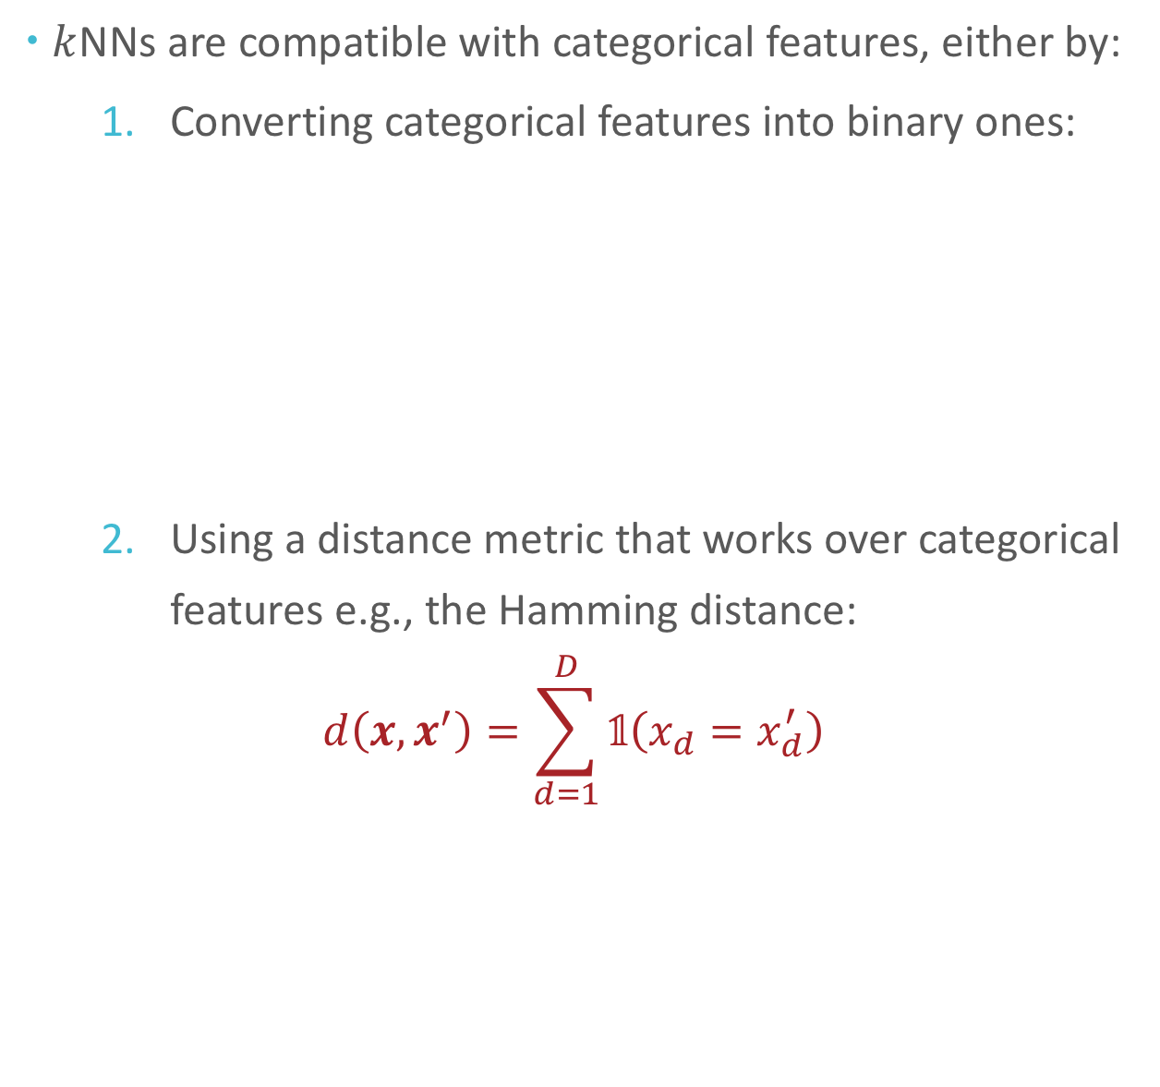

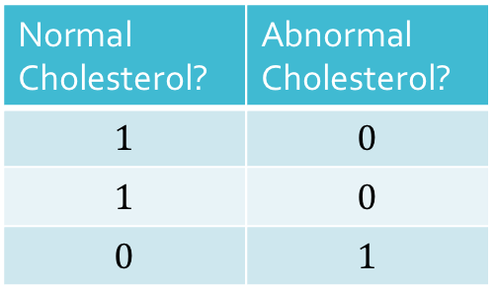
Aside: $k$NN and Categorical Features
$k$NNs are compatible with categorical features, either by:
Converting categorical features into binary ones:
Using a distance metric that works over categorical features e.g., the Hamming distance:
$$d\left(x,x^{′}\right)=\sum_{d=1}^{D}{\text{𝟙}\left(x_{d}=x_{d}^{′}\right)}$$
Cholesterol
Normal
Normal
Abnormal
Normal Cholesterol? | Abnormal Cholesterol?
$$1$$ | $$0$$
$$1$$ | $$0$$
$$0$$ | $$1$$

Slide 32
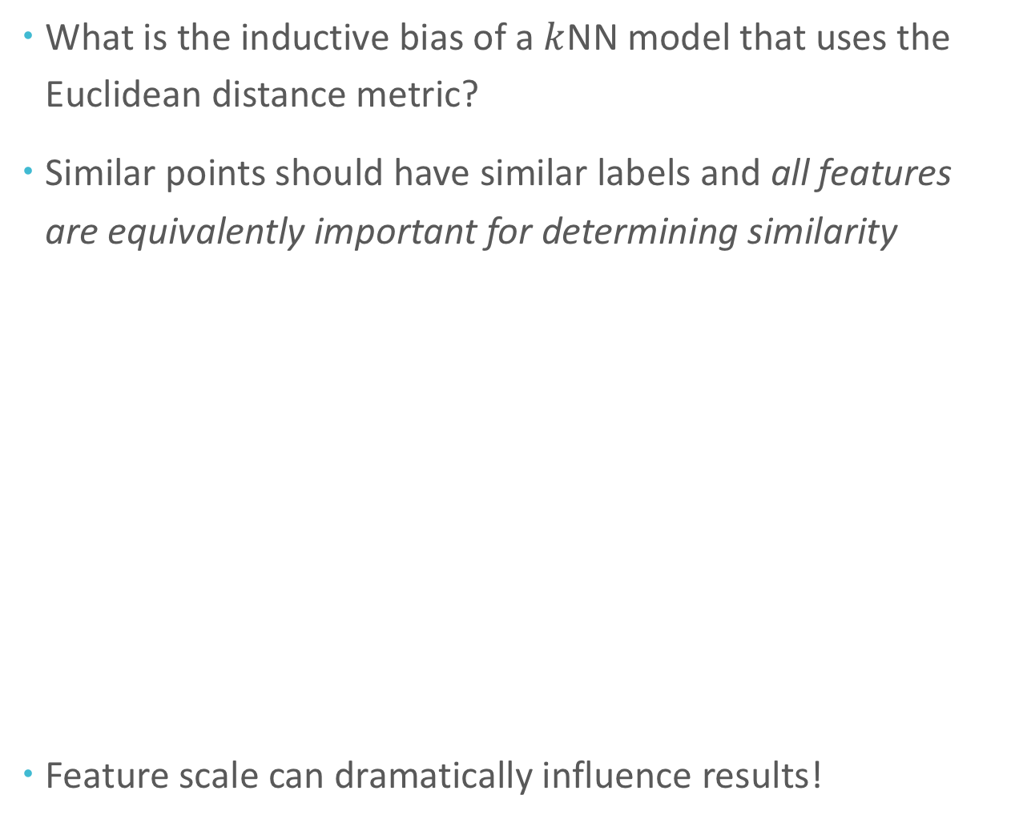

$k$NN: Inductive Bias
What is the inductive bias of a $k$NN model that uses the Euclidean distance metric?
Similar points should have similar labels and all features are equivalently important for determining similarity
Feature scale can dramatically influence results!
sepal length (cm)
sepal length (cm)
sepal width (cm)
sepal width (m)
Figure courtesy of Matt Gormley

Slide 33

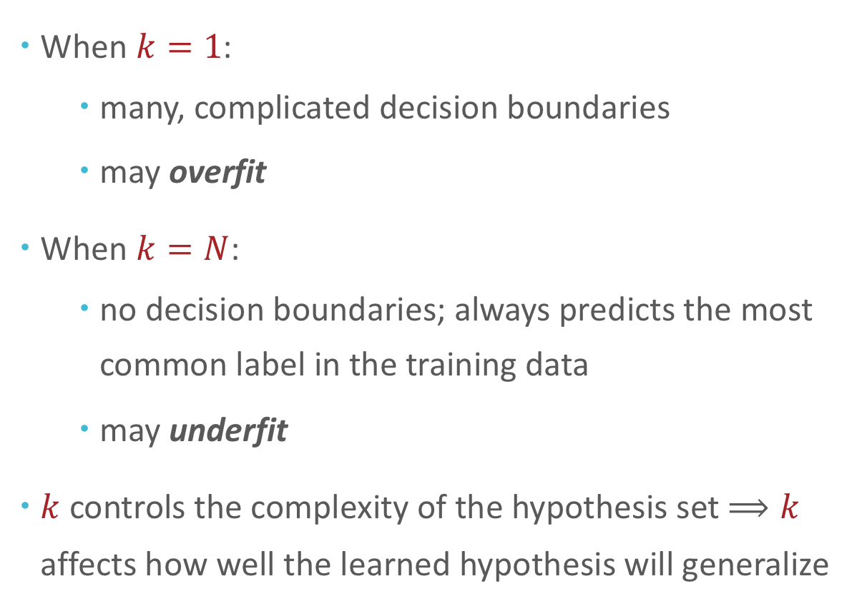
Setting $k$
When $k=1$:
many, complicated decision boundaries
may overfit
When $k=N$:
no decision boundaries; always predicts the most common label in the training data
may underfit
$k$ controls the complexity of the hypothesis set $⟹k$ affects how well the learned hypothesis will generalize

Slide 34
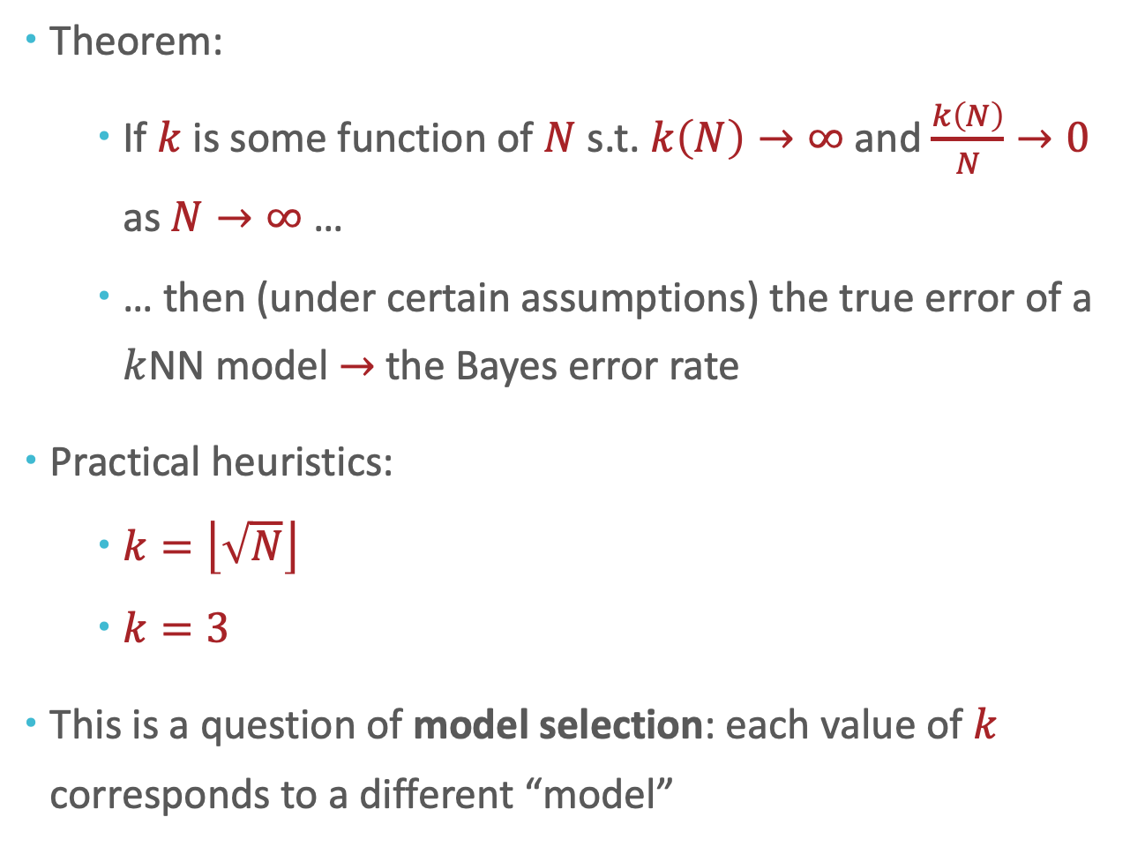
Setting $k$
Theorem:
If $k$ is some function of $N$ s.t. $k\left(N\right)→∞$ and $\frac{k\left(N\right)}{N}→0$ as $N→∞$ …
… then (under certain assumptions) the true error of a $k$NN model $→$the Bayes error rate
Practical heuristics:
$k=\left\lfloor \sqrt{N}\right\rfloor$
$k=3$
This is a question of model selection: each value of $k$ corresponds to a different “model”
Notes:
k large enough for statistical estimation
K is also small enough that it is a local vote, otherwise, it becomes a majority vote.

Slide 35
Model Selection
A model is a (typically infinite) set of classifiers that a learning algorithm searches through to find the best one (the ”hypothesis space”)
Model parameters are the numeric values or structure that are selected by the learning algorithm
Hyperparameters are the tunable aspects of the model that are not selected by the learning algorithm
Example: Decision Trees
Model = set of all possible trees, potentially narrowed down according to the hyperparameters (see below)
Model parameters = structure of a specific tree e.g., splits, split order, predictions at leaf nodes,
Hyperparameters = splitting criterion, max-depth, tie-breaking procedures, etc…

Slide 36
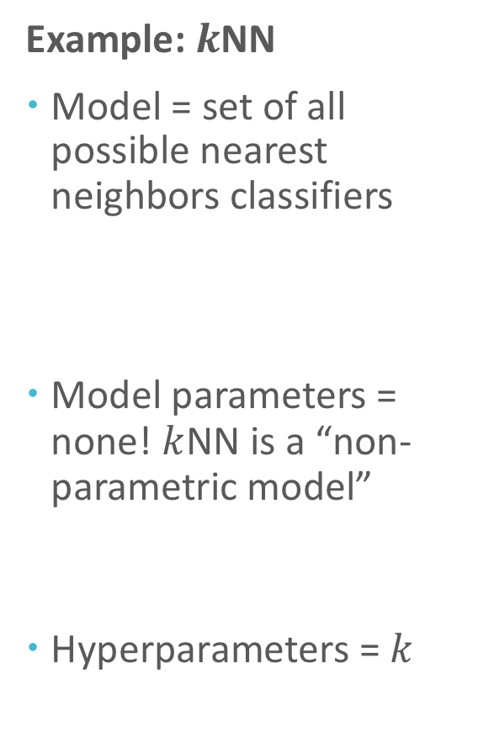
Model Selection
Example: $k$NN
Model = set of all possible nearest neighbors classifiers
Model parameters = none! $k$NN is a “non-parametric model”
Hyperparameters = $k$
A model is a (typically infinite) set of classifiers that a learning algorithm searches through to find the best one (the ”hypothesis space”)
Model parameters are the numeric values or structure that are selected by the learning algorithm
Hyperparameters are the tunable aspects of the model that are not selected by the learning algorithm

Slide 37
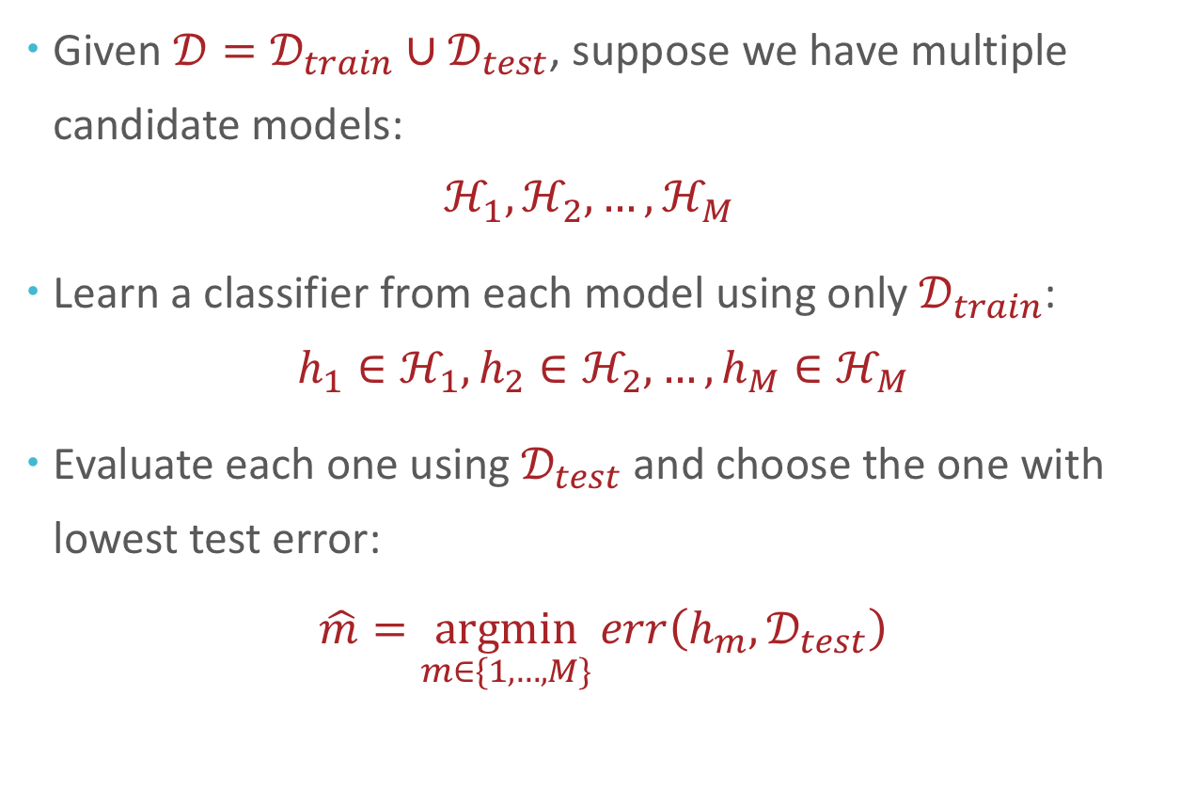
Model Selection with Test Sets
Given $𝒟=𝒟_{train}∪𝒟_{test}$, suppose we have multiple candidate models: $ℋ_{1}, ℋ_{2},…,ℋ_{M}$
Learn a classifier from each model using only $𝒟_{train}$: $h_{1}∈ℋ_{1}, h_{2}∈ℋ_{2},…,h_{M}∈ℋ_{M}$
Evaluate each one using $𝒟_{test}$ and choose the one with lowest test error:
$$\hat{m}=\underset{m∈\{1,…,M\}}{argmin}{err\left(h_{m},𝒟_{test}\right)}$$

Slide 38
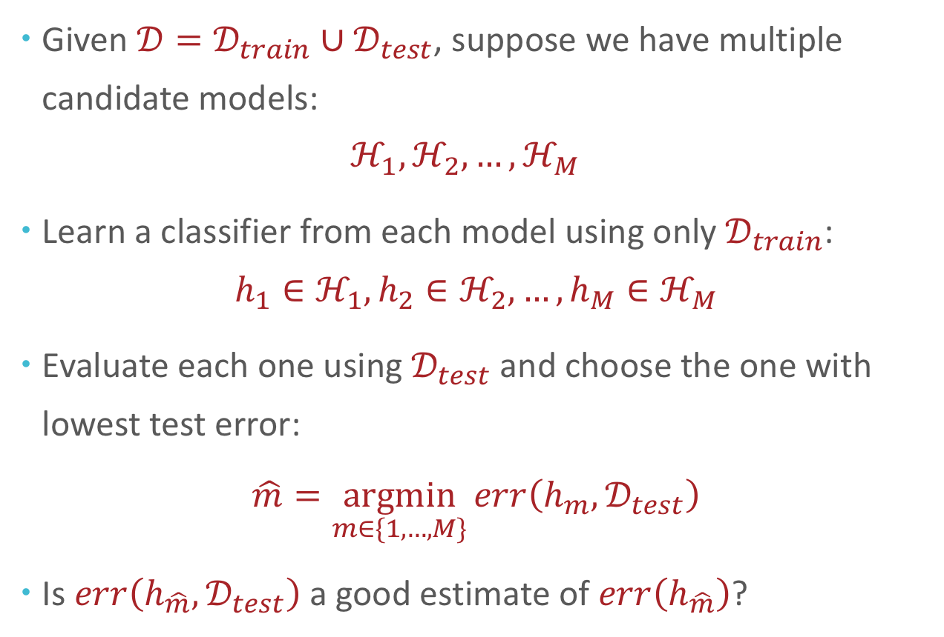
Model Selection with Test Sets?
Given $𝒟=𝒟_{train}∪𝒟_{test}$, suppose we have multiple candidate models: $ℋ_{1}, ℋ_{2},…,ℋ_{M}$
Learn a classifier from each model using only $𝒟_{train}$: $h_{1}∈ℋ_{1}, h_{2}∈ℋ_{2},…,h_{M}∈ℋ_{M}$
Evaluate each one using $𝒟_{test}$ and choose the one with lowest test error:
$$\hat{m}=\underset{m∈\{1,…,M\}}{argmin}{err\left(h_{m},𝒟_{test}\right)}$$
Is $err\left(h_{\hat{m}},𝒟_{test}\right)$a good estimate of $err\left(h_{\hat{m}}\right)$?

Slide 39

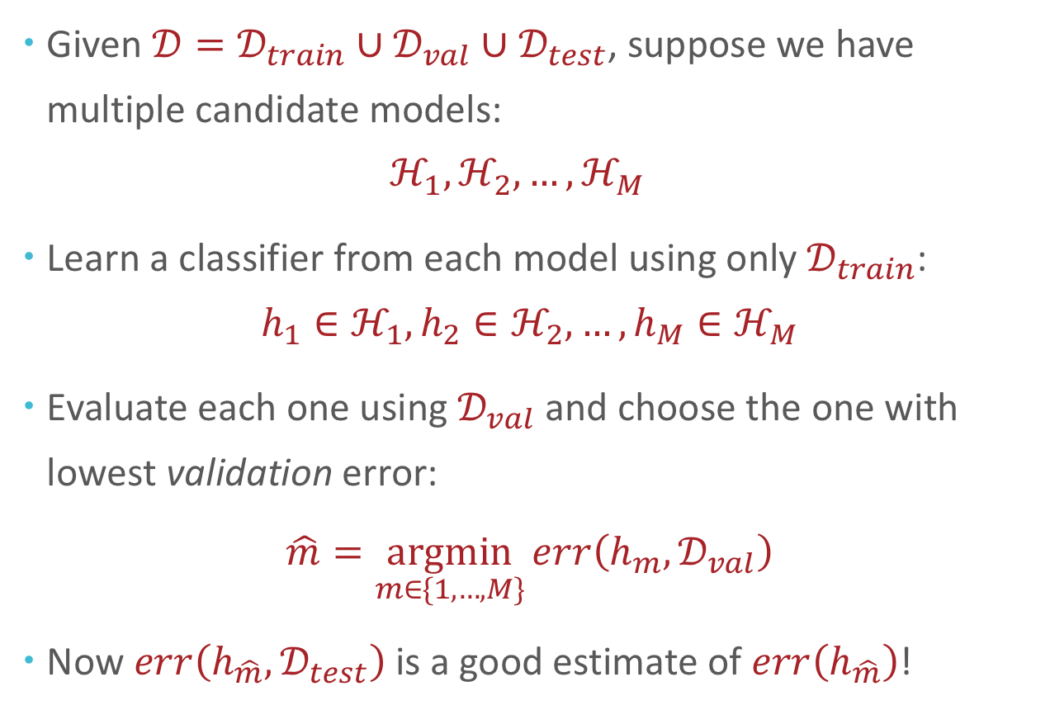





Model Selection with Validation Sets
Given $𝒟=𝒟_{train}∪𝒟_{val}∪𝒟_{test}$, suppose we have multiple candidate models: $ℋ_{1}, ℋ_{2},…,ℋ_{M}$
Learn a classifier from each model using only $𝒟_{train}$: $h_{1}∈ℋ_{1}, h_{2}∈ℋ_{2},…,h_{M}∈ℋ_{M}$
Evaluate each one using $𝒟_{val}$ and choose the one with lowest validation error:
$$\hat{m}=\underset{m∈\{1,…,M\}}{argmin}{err\left(h_{m},𝒟_{val}\right)}$$
Now $err\left(h_{\hat{m}},𝒟_{test}\right)$is a good estimate of $err\left(h_{\hat{m}}\right)$!

Slide 40
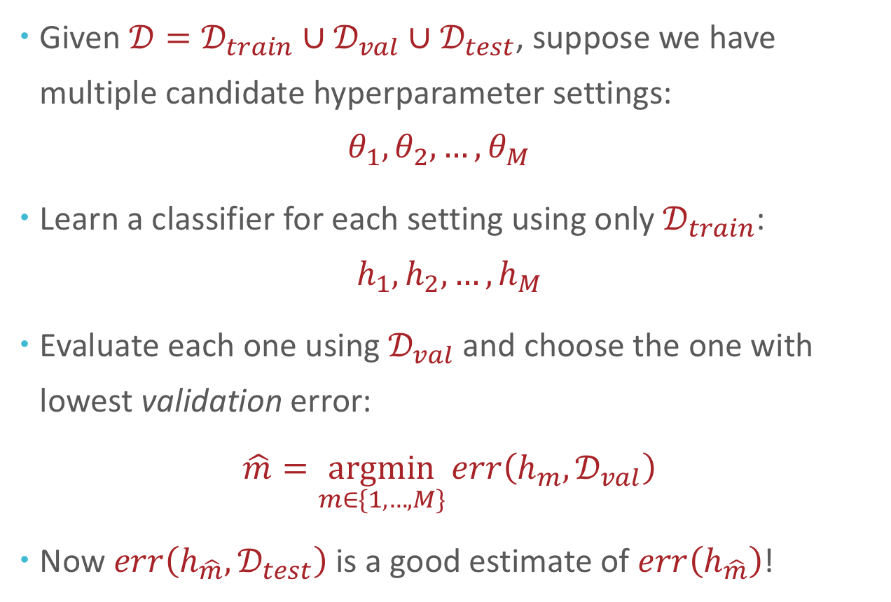
Hyperparameter Optimization with Validation Sets
Given $𝒟=𝒟_{train}∪𝒟_{val}∪𝒟_{test}$, suppose we have multiple candidate hyperparameter settings: $θ_{1}, θ_{2},…,θ_{M}$
Learn a classifier for each setting using only $𝒟_{train}$: $h_{1}, h_{2},…,h_{M}$
Evaluate each one using $𝒟_{val}$ and choose the one with lowest validation error:
$$\hat{m}=\underset{m∈\{1,…,M\}}{argmin}{err\left(h_{m},𝒟_{val}\right)}$$
Now $err\left(h_{\hat{m}},𝒟_{test}\right)$is a good estimate of $err\left(h_{\hat{m}}\right)$!

Slide 41

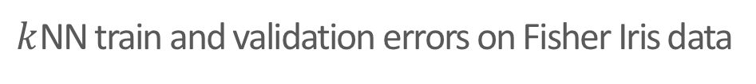
Setting $k$ for $k$NN with Validation Sets
$k$NN train and validation errors on Fisher Iris data
Figure courtesy of Matt Gormley

Slide 42
How should we partition our dataset?
$k$NN train and validation errors on Fisher Iris data
Figure courtesy of Matt Gormley
Notes:
So, here we excluded the query point, and empirically it is a better metric. Otgerwise, it becomes pure memorization.

Slide 43
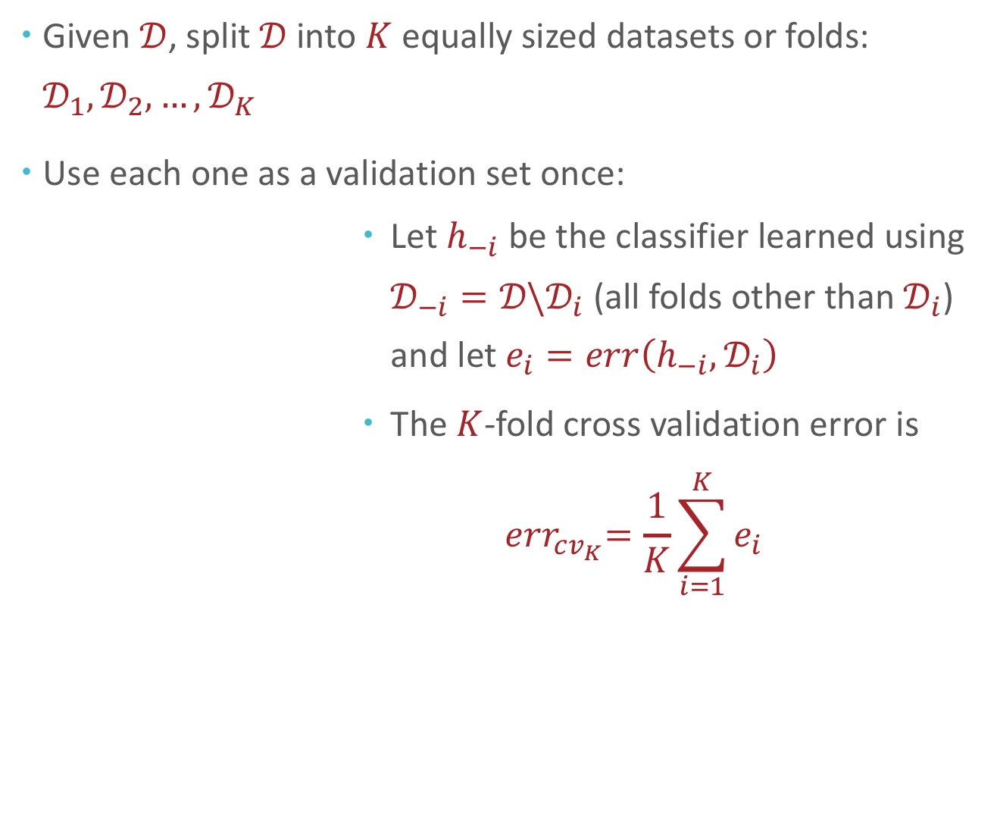

Given $𝒟$, split $𝒟$ into $K$ equally sized datasets or folds: $𝒟_{1},𝒟_{2},…,𝒟_{K}$
Use each one as a validation set once:
Let $h_{−i}$ be the classifier learned using $𝒟_{−i}=𝒟\backslash 𝒟_{i}$ (all folds other than $𝒟_{i}$) and let $e_{i}=err\left(h_{−i},𝒟_{i}\right)$
The $K$-fold cross validation error is
$${ err}_{cv_{K}}=\frac{1}{K}\sum_{i=1}^{K}{e_{i}}$$
$K$-fold cross-validation:
What if we don’t have enough data for $D_{val}$?
Fold 1
Fold 2
Fold 3
Fold 4
Notes:
Ultimately, even though these techniques have some theoretical foundations, their use is not mathematically justified; same thing with regularization (where did the sum of squares constraint even come from) where we have some idea of the practical task or information we want to get at so we just use a heuristic or creative idea and verify or confirm that it works well empirically, across a wide range of ML settings.
This is the kind of stuff that makes ML really exciting: once you get past the theory, you just to get try things and see what works. You get to think creatively about your problem, come up with solutions, test them out and see what works.
Let me give you an example

Slide 44



Given $𝒟$, split $𝒟$ into $K$ equally sized datasets or folds: $𝒟_{1},𝒟_{2},…,𝒟_{K}$
Use each one as a validation set once:
Let $h_{−i}$ be the classifier learned using $𝒟_{−i}=𝒟\backslash 𝒟_{i}$ (all folds other than $𝒟_{i}$) and let $e_{i}=err\left(h_{−i},𝒟_{i}\right)$
The $K$-fold cross validation error is
$${ err}_{cv_{K}}=\frac{1}{K}\sum_{i=1}^{K}{e_{i}}$$
$K$-fold cross-validation
$$𝒟_{1}$$
Fold 1
$$𝒟_{−1}$$
Fold 2
Fold 3
Fold 4
Notes:
Ultimately, even though these techniques have some theoretical foundations, their use is not mathematically justified; same thing with regularization (where did the sum of squares constraint even come from) where we have some idea of the practical task or information we want to get at so we just use a heuristic or creative idea and verify or confirm that it works well empirically, across a wide range of ML settings.
This is the kind of stuff that makes ML really exciting: once you get past the theory, you just to get try things and see what works. You get to think creatively about your problem, come up with solutions, test them out and see what works.
Let me give you an example

Slide 45

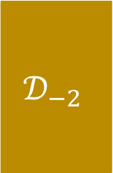
Given $𝒟$, split $𝒟$ into $K$ equally sized datasets or folds: $𝒟_{1},𝒟_{2},…,𝒟_{K}$
Use each one as a validation set once:
Let $h_{−i}$ be the classifier learned using $𝒟_{−i}=𝒟\backslash 𝒟_{i}$ (all folds other than $𝒟_{i}$) and let $e_{i}=err\left(h_{−i},𝒟_{i}\right)$
The $K$-fold cross validation error is
$${ err}_{cv_{K}}=\frac{1}{K}\sum_{i=1}^{K}{e_{i}}$$
$K$-fold cross-validation
Fold 1
$$𝒟_{2}$$
Fold 2
$$𝒟_{−2}$$
Fold 3
Fold 4
Notes:
Ultimately, even though these techniques have some theoretical foundations, their use is not mathematically justified; same thing with regularization (where did the sum of squares constraint even come from) where we have some idea of the practical task or information we want to get at so we just use a heuristic or creative idea and verify or confirm that it works well empirically, across a wide range of ML settings.
This is the kind of stuff that makes ML really exciting: once you get past the theory, you just to get try things and see what works. You get to think creatively about your problem, come up with solutions, test them out and see what works.
Let me give you an example

Slide 46


Given $𝒟$, split $𝒟$ into $K$ equally sized datasets or folds: $𝒟_{1},𝒟_{2},…,𝒟_{K}$
Use each one as a validation set once:
Let $h_{−i}$ be the classifier learned using $𝒟_{−i}=𝒟\backslash 𝒟_{i}$ (all folds other than $𝒟_{i}$) and let $e_{i}=err\left(h_{−i},𝒟_{i}\right)$
The $K$-fold cross validation error is
$${ err}_{cv_{K}}=\frac{1}{K}\sum_{i=1}^{K}{e_{i}}$$
$K$-fold cross-validation
$$𝒟_{−3}$$
Fold 1
Fold 2
$$𝒟_{3}$$
Fold 3
Fold 4
Notes:
Ultimately, even though these techniques have some theoretical foundations, their use is not mathematically justified; same thing with regularization (where did the sum of squares constraint even come from) where we have some idea of the practical task or information we want to get at so we just use a heuristic or creative idea and verify or confirm that it works well empirically, across a wide range of ML settings.
This is the kind of stuff that makes ML really exciting: once you get past the theory, you just to get try things and see what works. You get to think creatively about your problem, come up with solutions, test them out and see what works.
Let me give you an example

Slide 47


Given $𝒟$, split $𝒟$ into $K$ equally sized datasets or folds: $𝒟_{1},𝒟_{2},…,𝒟_{K}$
Use each one as a validation set once:
Let $h_{−i}$ be the classifier learned using $𝒟_{−i}=𝒟\backslash 𝒟_{i}$ (all folds other than $𝒟_{i}$) and let $e_{i}=err\left(h_{−i},𝒟_{i}\right)$
The $K$-fold cross validation error is
$${ err}_{cv_{K}}=\frac{1}{K}\sum_{i=1}^{K}{e_{i}}$$
$K$-fold cross-validation
$$𝒟_{−4}$$
Fold 1
Fold 2
Fold 3
$$𝒟_{4}$$
Fold 4
Notes:
Ultimately, even though these techniques have some theoretical foundations, their use is not mathematically justified; same thing with regularization (where did the sum of squares constraint even come from) where we have some idea of the practical task or information we want to get at so we just use a heuristic or creative idea and verify or confirm that it works well empirically, across a wide range of ML settings.
This is the kind of stuff that makes ML really exciting: once you get past the theory, you just to get try things and see what works. You get to think creatively about your problem, come up with solutions, test them out and see what works.
Let me give you an example

Slide 48
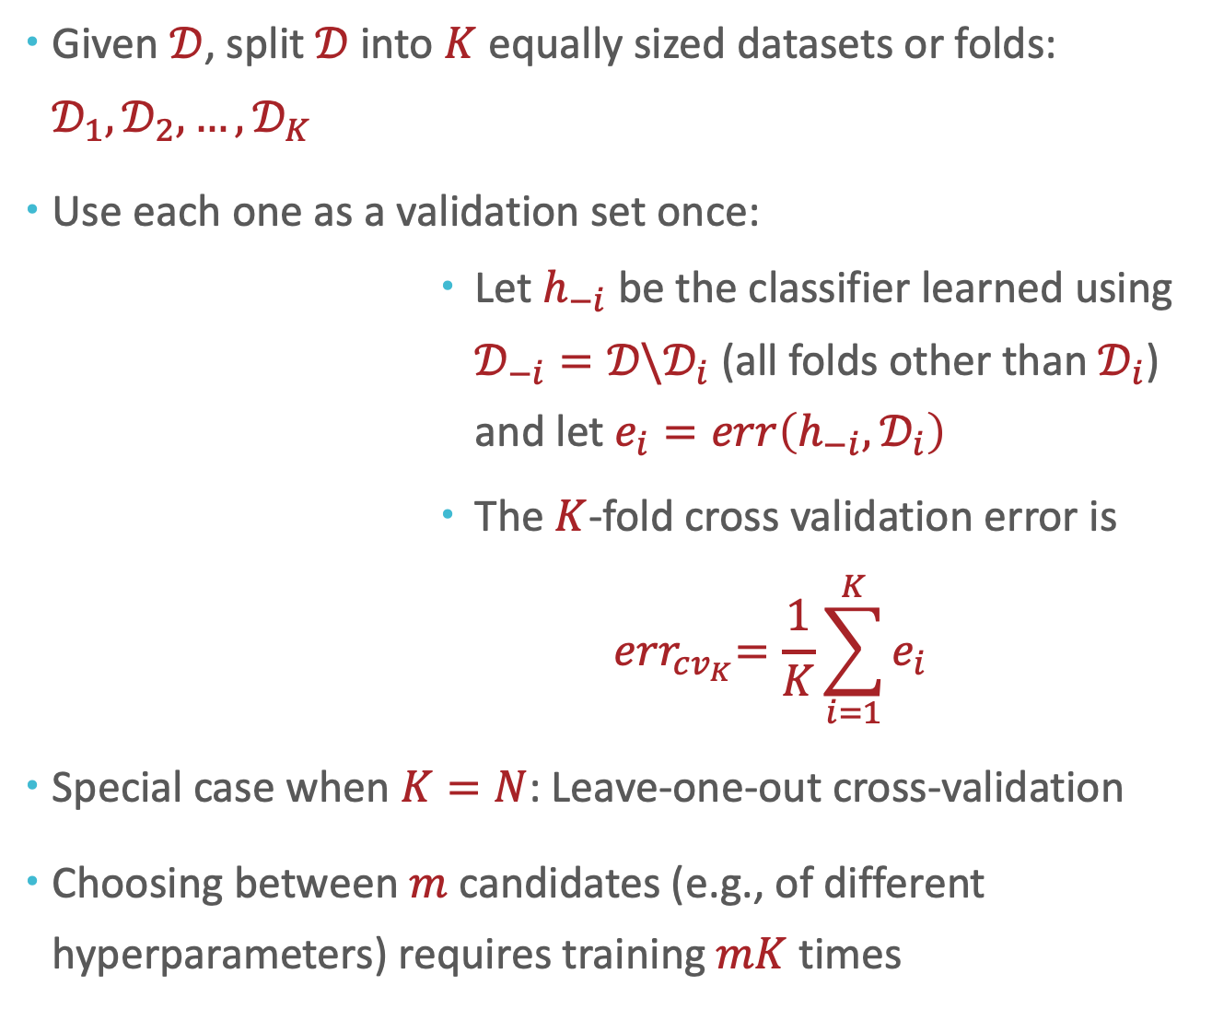
Given $𝒟$, split $𝒟$ into $K$ equally sized datasets or folds: $𝒟_{1},𝒟_{2},…,𝒟_{K}$
Use each one as a validation set once:
Let $h_{−i}$ be the classifier learned using $𝒟_{−i}=𝒟\backslash 𝒟_{i}$ (all folds other than $𝒟_{i}$) and let $e_{i}=err\left(h_{−i},𝒟_{i}\right)$
The $K$-fold cross validation error is
$${ err}_{cv_{K}}=\frac{1}{K}\sum_{i=1}^{K}{e_{i}}$$
Special case when $K=N$: Leave-one-out cross-validation
Choosing between $m$ candidates (e.g., of different hyperparameters) requires training $mK$ times
$K$-fold cross-validation
Fold 1
Fold 2
Fold 3
Fold 4
Notes:
Ultimately, even though these techniques have some theoretical foundations, their use is not mathematically justified; same thing with regularization (where did the sum of squares constraint even come from) where we have some idea of the practical task or information we want to get at so we just use a heuristic or creative idea and verify or confirm that it works well empirically, across a wide range of ML settings.
This is the kind of stuff that makes ML really exciting: once you get past the theory, you just to get try things and see what works. You get to think creatively about your problem, come up with solutions, test them out and see what works.
Let me give you an example

Slide 49
Summary
 | Input | Output
Training | training dataset hyperparameters | best model parameters
Hyperparameter Optimization | training dataset validation dataset | best hyperparameters
Cross-Validation | training dataset validation dataset | cross-validation error
Testing | test dataset classifier | test error

Slide 50
The slides are adapted based on materials shared by Prof. Henry Chai from CMU.

